Slide 1

ANALYZE AND VISUALIZE SWIGGY FOOD DELIVERY TIME FOR DIFFERENT CUISINES
INT 200 INTERNSHIP
FINAL REVIEW
TEAM MEMBERS
Ruthvika Muchala(E0121036)
PROJECT GUIDE
Prof. Santhiya

Slide 2
INTRODUCTION
Data visualization helps in presenting billions of data points into meaningful insights. It is a very important tool for all the data scientists to learn and understand the data in more details.
Visualization also helps business leaders to take important decisions for company growth and to move in the right direction.
Consumers are increasingly using food delivery apps (FDAs) to facilitate convenient and quick food delivery.
Significant popularity that FDAs have gained in both developed and emerging countries can be attributed to reasons related to their capacity to (a) facilitate convenient and swift food delivery to customers' doorsteps and (b) provide restaurants with more opportunities to increase revenue without increasing restaurants' seating capacities.

Slide 3
PROBLEM STATEMENT
Future of online food ordering website is bright. Facilities, Comfort, User friendliness are the key features of online websites success.
We often order food from food delivery apps like Zomato, Swiggy. Sometimes it often takes time to deliver the food. There are factors which impact the delivery time of the food.
Delivery time for an order is determined by various factors like distance, area, Restaurant rating , etc..

Slide 4
OBJECTIVES
Visually analyse the various factors involved in delivery of food to the customer for different cuisines with using Tableau.
This Project Specifically analyse it for Swiggy Food Delivery app.

Slide 5
RESEARCH/PRODUCT SURVEY
An Analysis of Online Food Ordering Applications in India: Zomato and Swiggy
https://www.researchgate.net/publication/348880558_An_Analysis_of_Online_Food_Ordering_Applications_in_India_Zomato_and_Swiggy
A Study on Impact of Online Food delivery app on Restaurant Business special reference to zomato and swiggy
http://ijrar.com/upload_issue/ijrar_issue_20542895.pdf
End-to-End Predictive Analysis on Zomato
https://www.analyticsvidhya.com/blog/2021/10/end-to-end-predictive-analysis-on-zomato/

Slide 6
RESEARCH NOTES
For newly opened restaurants and restaurants with blank they converted the value to 0.
It is important to separate out the independent and dependent variables from all the dataset samples.
Before we begin to create a model, make sure we have a small dataset to test our model performance.
Addresses & Cuisines are categorical variables that need to be cleaned before encoding.
Rating & Reviews needs to be cleaned and converted to respective types.

Slide 7
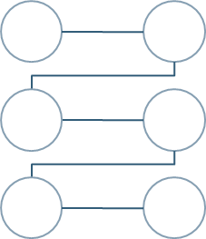
WORKFLOW/METHODOLOGY
Data
collection
Data
Entry
Research
Learning
Tableau
Framing
questionnaires
Data
analysis

Slide 8
DATASET DETAILS
COLUMN NAME | DESCRIPTION
Quantity | The quantity of items in the order.
Item Price | The total price of all items
Packaging Charges | The price for packaging of items.
Delivery Partner Fee | The fee for the delivery partner.
Discount Applied | The amount deducted as discount.
Taxes | The tax charge like GST.
Bill Total | The total amount including the item prices and all the prices after deducting the discount.
Mode Of Payment | The mode in which the price was paid.(cash, UPI etc.)
Order Time | The time at which the order was placed.

Slide 9
COLUMN NAME | DESCRIPTION
Order ID | Unique series of numbers that is given to each order.
Customer ID | Unique series of numbers that is given to each customer.
State | The state from which the order is placed.
Place | The city and district of the state.
Delivery Address | Where the order should be delivered.
Restaurant Name | The restaurant where the order was placed.
Restaurant Address | From where the order should be picked up.(Restaurant location)
Cuisine | The cuisine to which the restaurant belongs.

Slide 10
COLUMN NAME | DESCRIPTON
Delivery Time | The time at which the order was delivered.
Estimated Time (in mins) | The time estimated by the app at which the order will be delivered.
Rating | The rating out of 5 given by the customer about the items they ordered.
Reviews | The review and criticism for the items ordered.

Slide 11
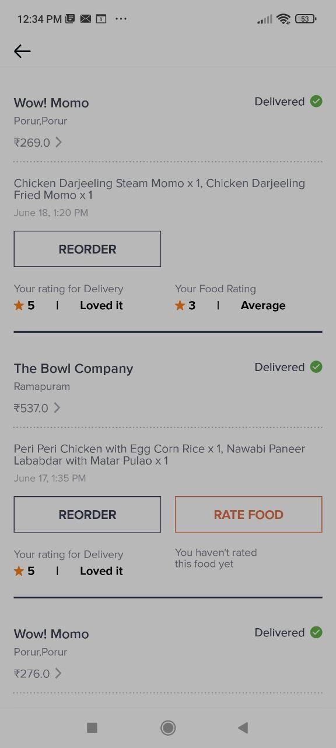
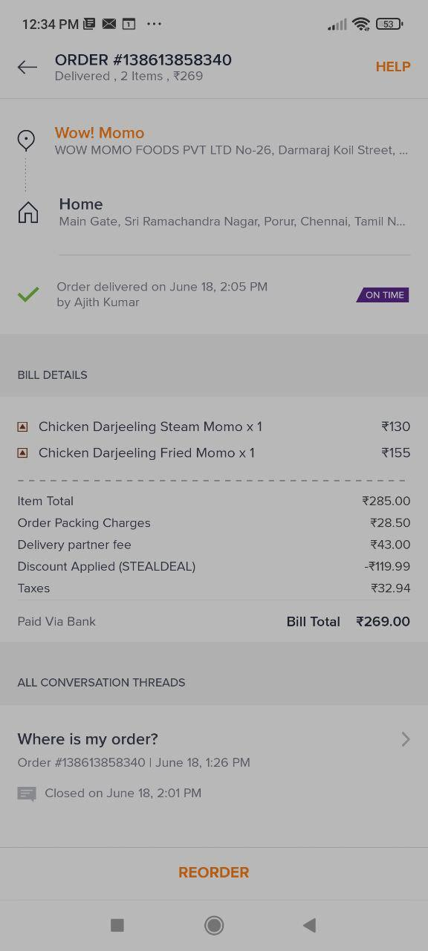
SAMPLE DATA

Slide 12
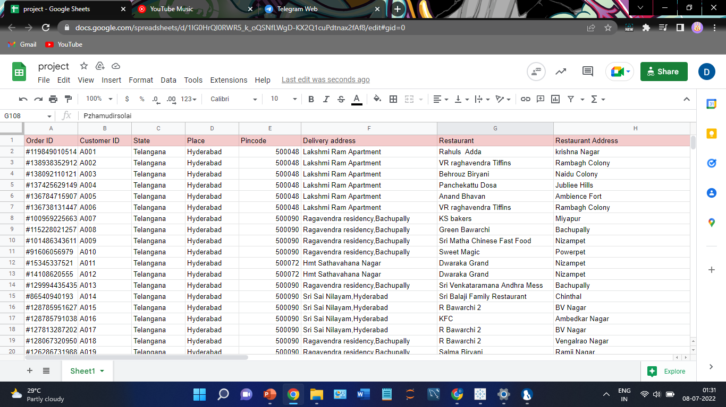
DATASET COLLECTED

Slide 13
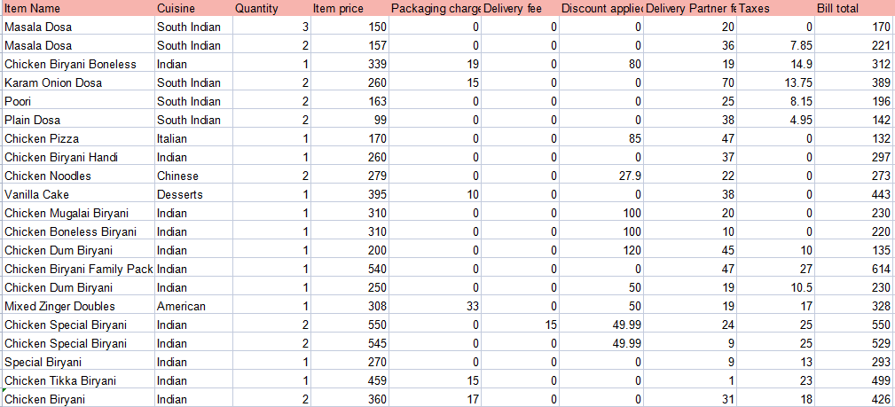

Slide 14
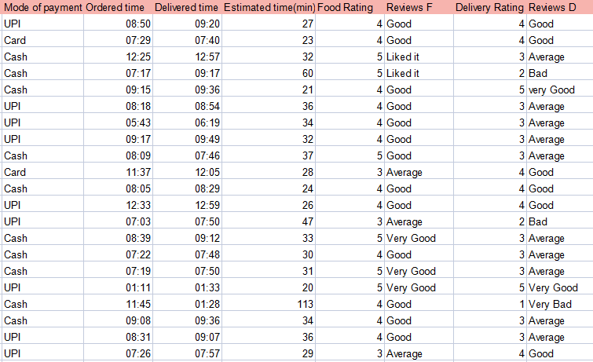

Slide 15
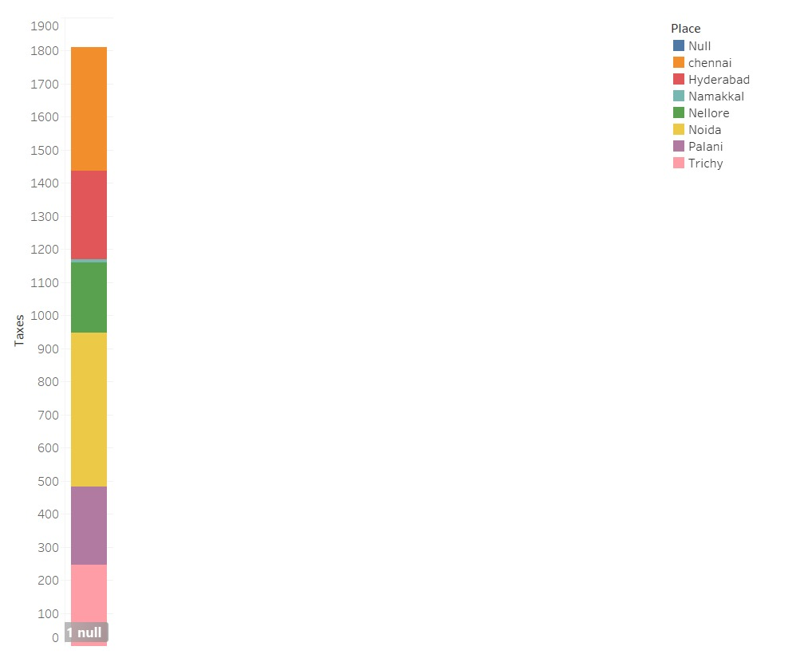
1.Which place collects more taxes compared to other places from the data collected ?
DATA BASED QUESTIONNAIRES

Slide 16
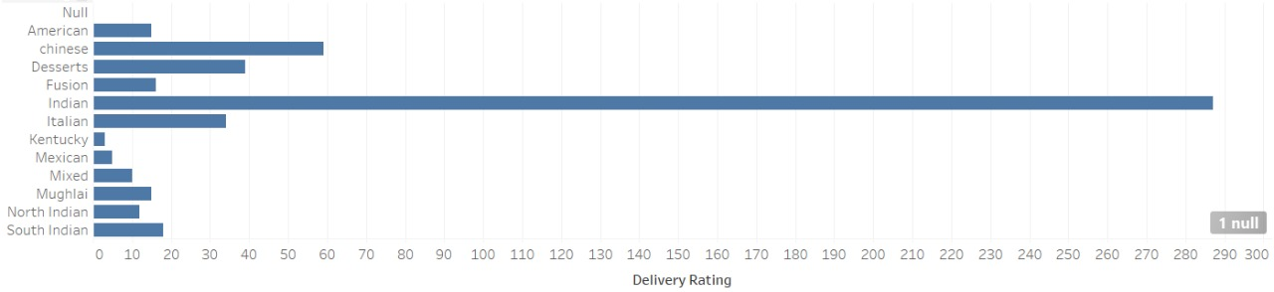
2.Which cuisine got the best delivery rating ?

Slide 17
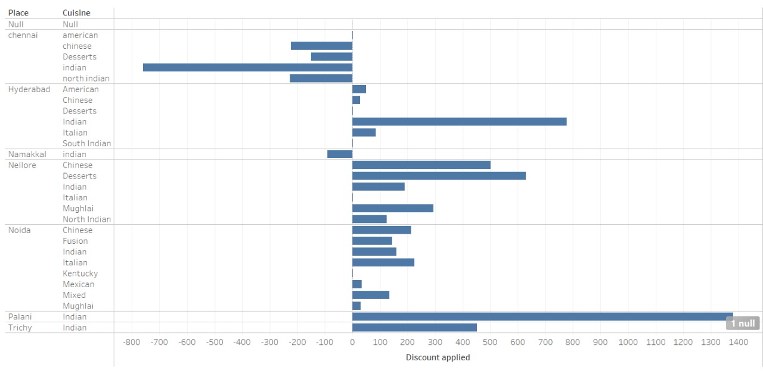
3.In Noida which cuisine got the greatest discount on food ?​

Slide 18
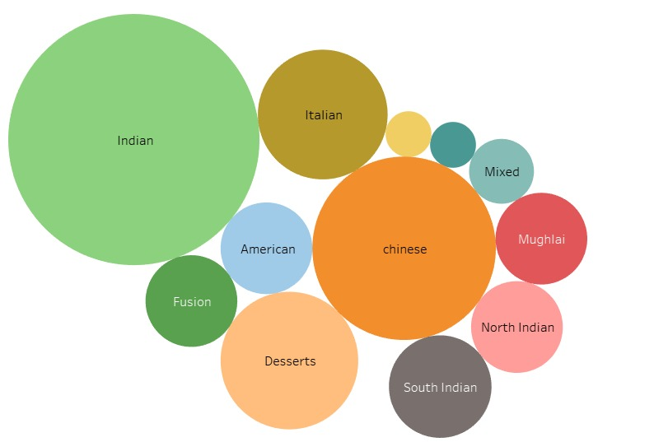
4.Which cuisine took most time to get delivered to the customer ?​

Slide 19
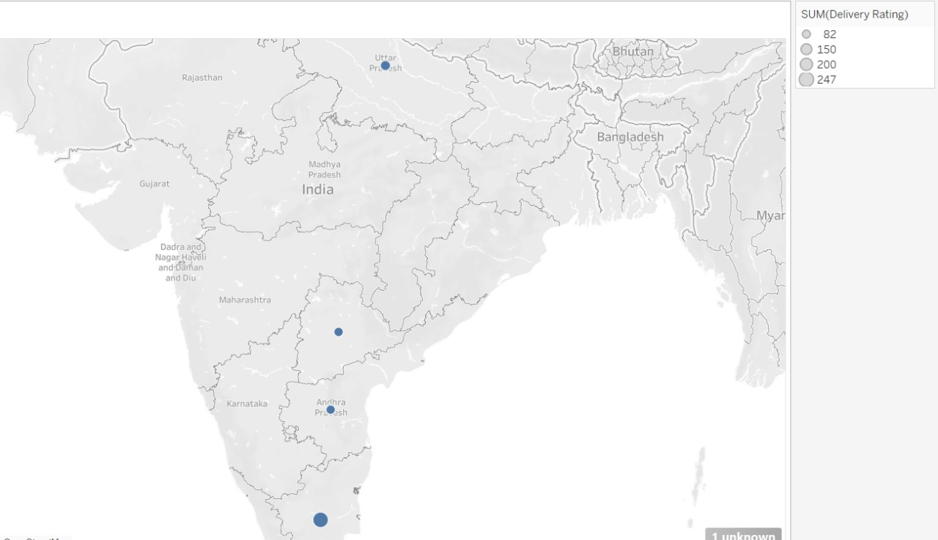
5.Interpret the given graph and tell which place got the best delivery rating ?​

Slide 20
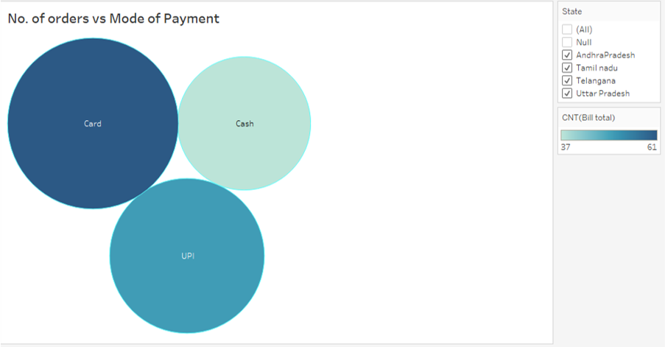
6.Which is the most used mode of payment overall?

Slide 21
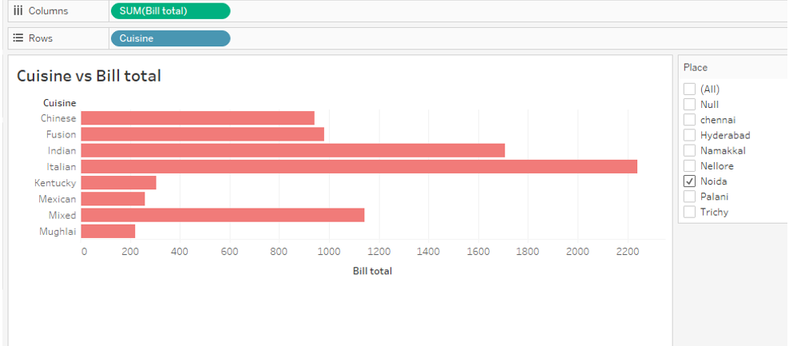
7.Which is the cuisine in which most money was spent in Noida?​

Slide 22
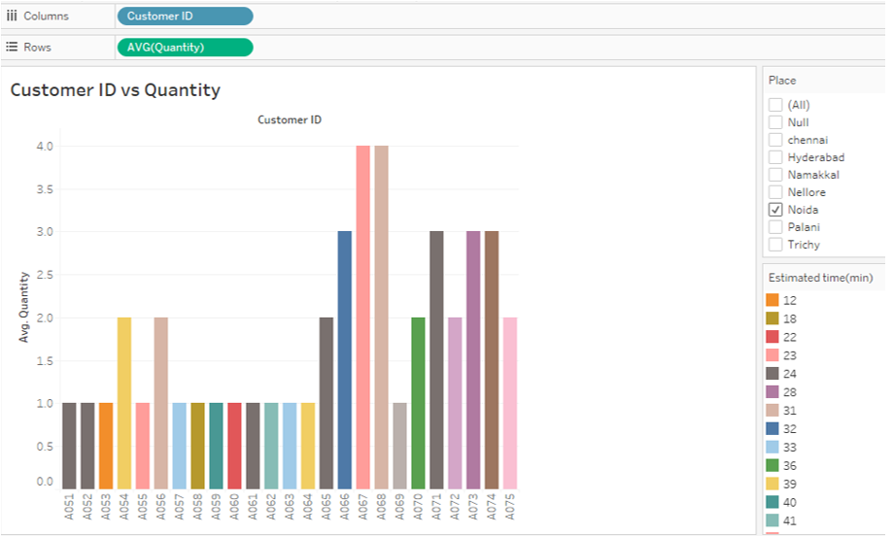
8.Find the Customer ID(s) which ordered the largest quantity of items in the place 'Noida'?​

Slide 23
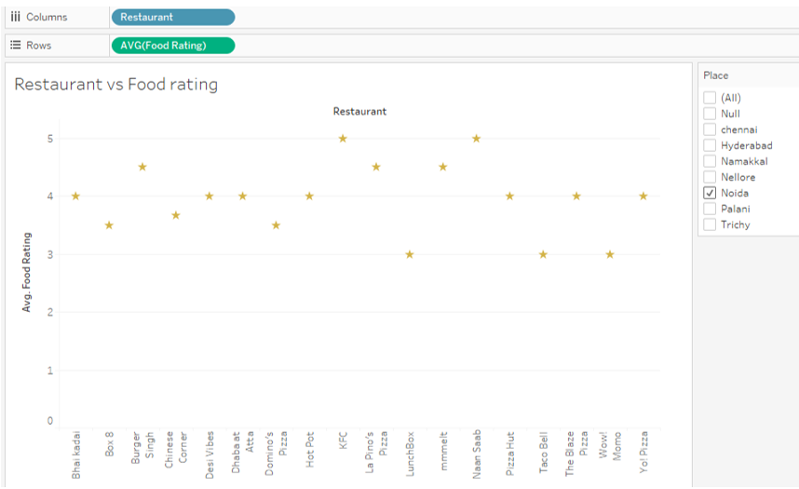
9.Which are the restaurants with highest food rating compared to other restaurants in Noida?​

Slide 24
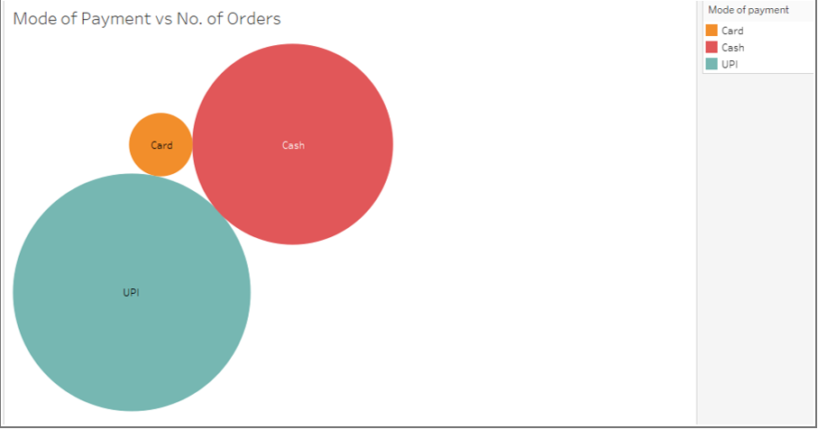
10.Which is the most used mode of payment in Noida?

Slide 25
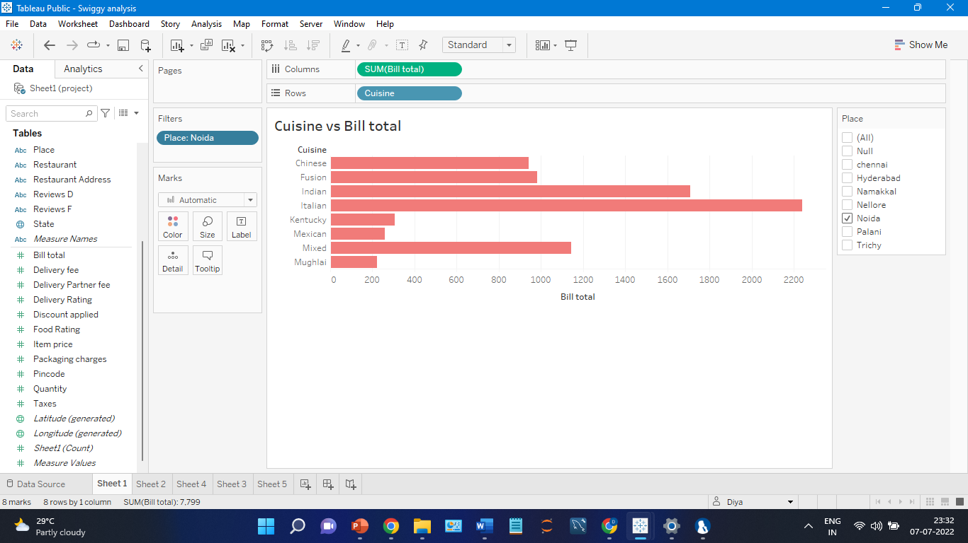
11.Which is the cuisine in which most money was spent in the place ‘Noida’?

Slide 26
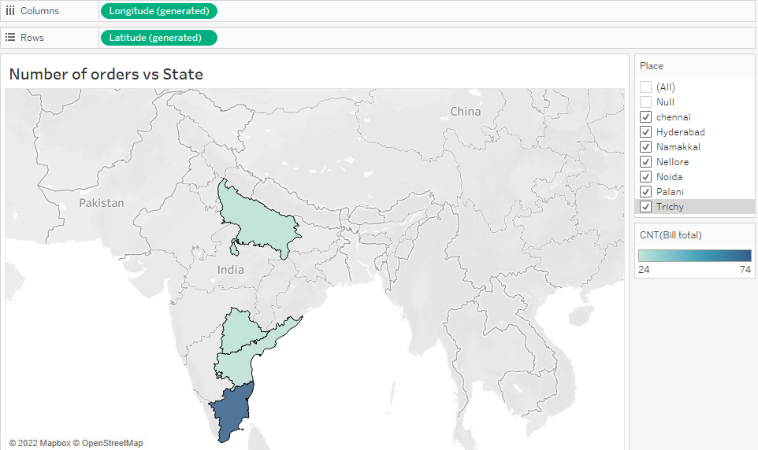
12.From which state in India were the most orders placed?

Slide 27
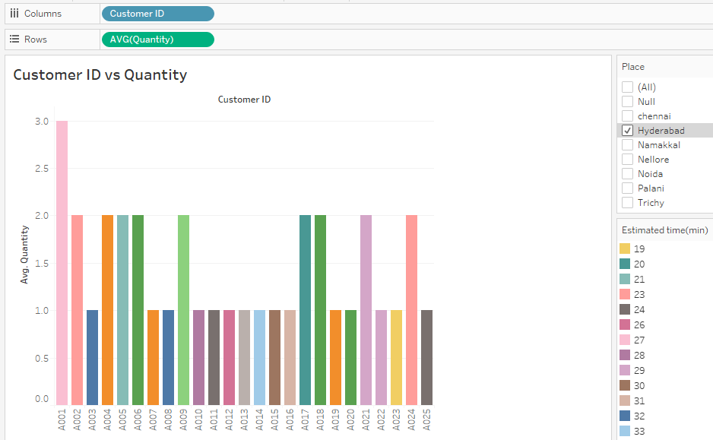
13.Find the Customer ID which ordered the largest quantity of items in the place ‘Hyderabad’.

Slide 28
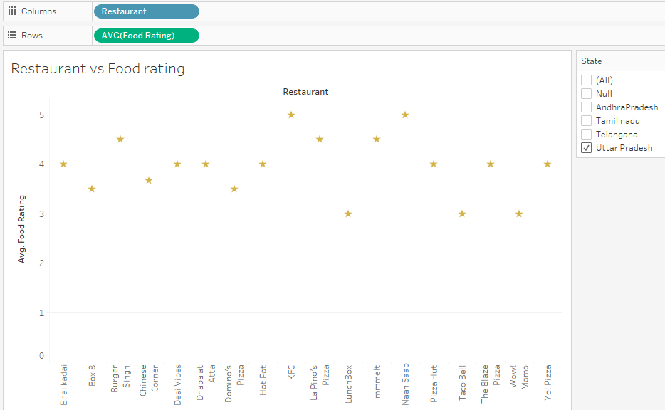
14.Which are the restaurants with the highest food rating compared to other restaurants in ‘Uttar Pradesh’?

Slide 29
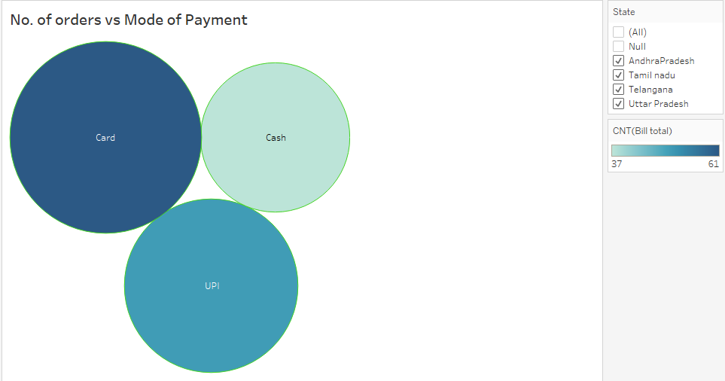
15.Which is the most used mode of payment overall?

Slide 30
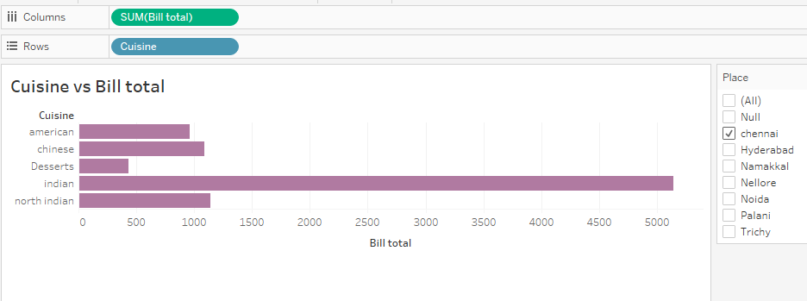
16.Which is the cuisine in which most money was spent in the place ‘Chennai’?

Slide 31
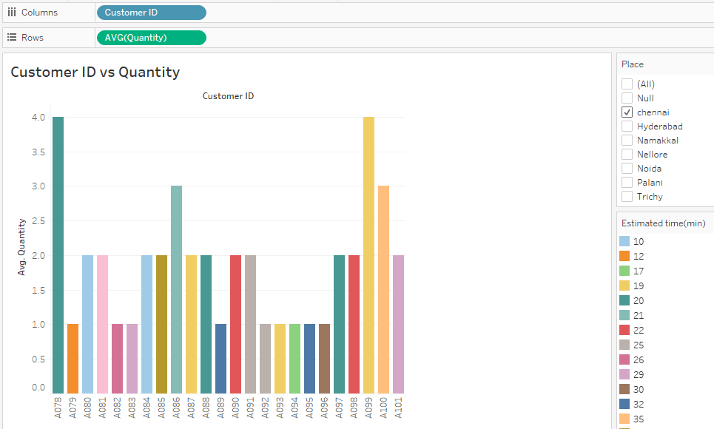
17.Find the Customer ID(s) which ordered the largest quantity of items in the place ‘Chennai’?

Slide 32
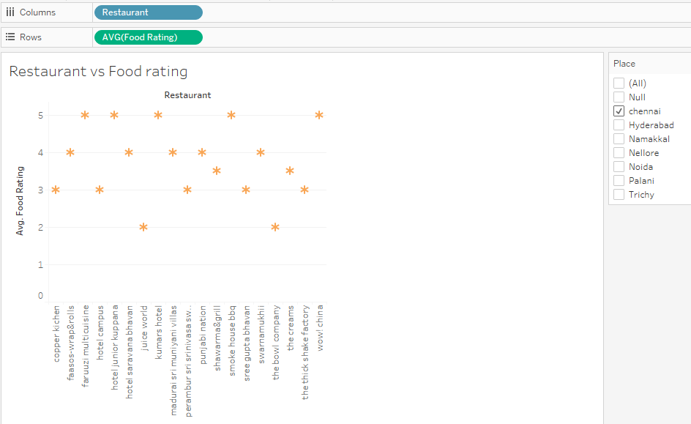
18.Which are the restaurants with the highest food rating compared to other restaurants in ‘Chennai’?

Slide 33
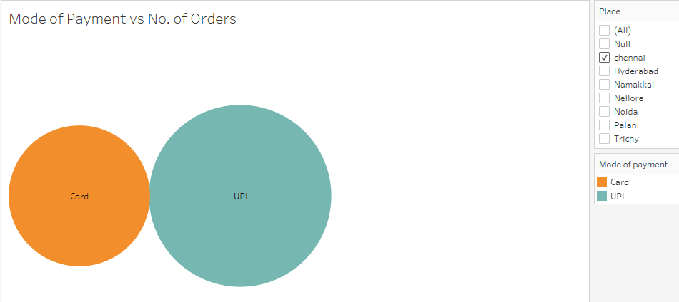
19.Which is the most used mode of payment in ‘Chennai’?

Slide 34
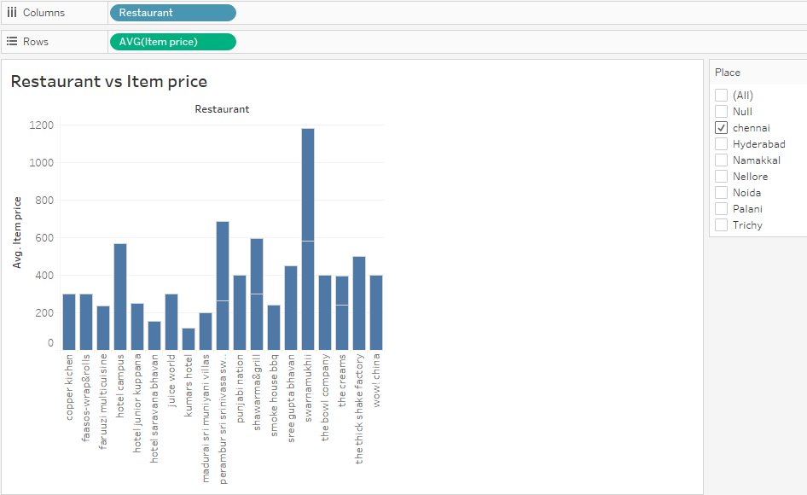
20.Which food item in Chennai is most expensive according to the data collected?

Slide 35
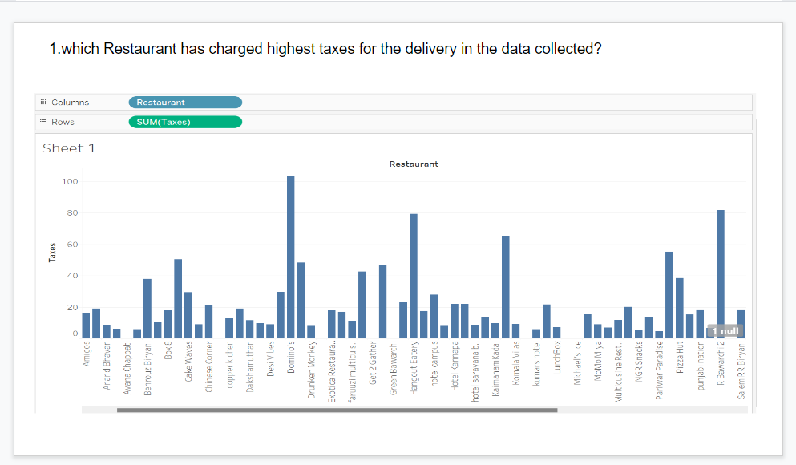
21.

Slide 36
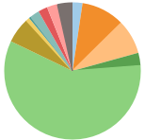
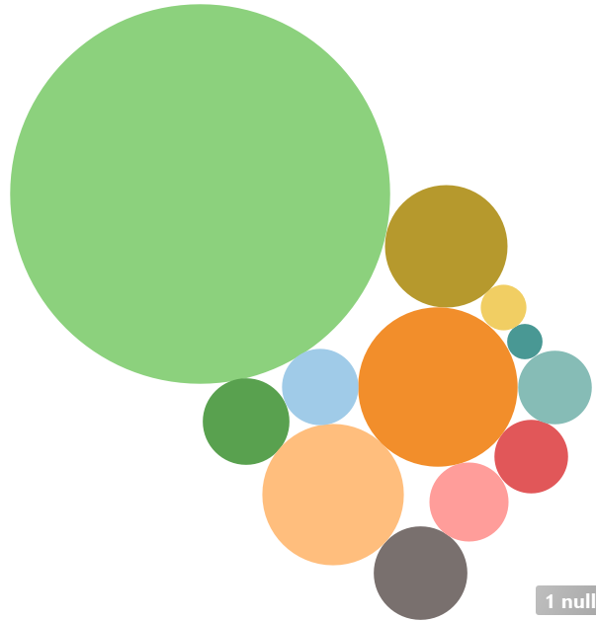
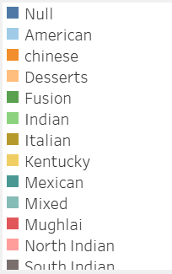
22. which cuisine has the lowest food rating in the dataset?

Slide 37
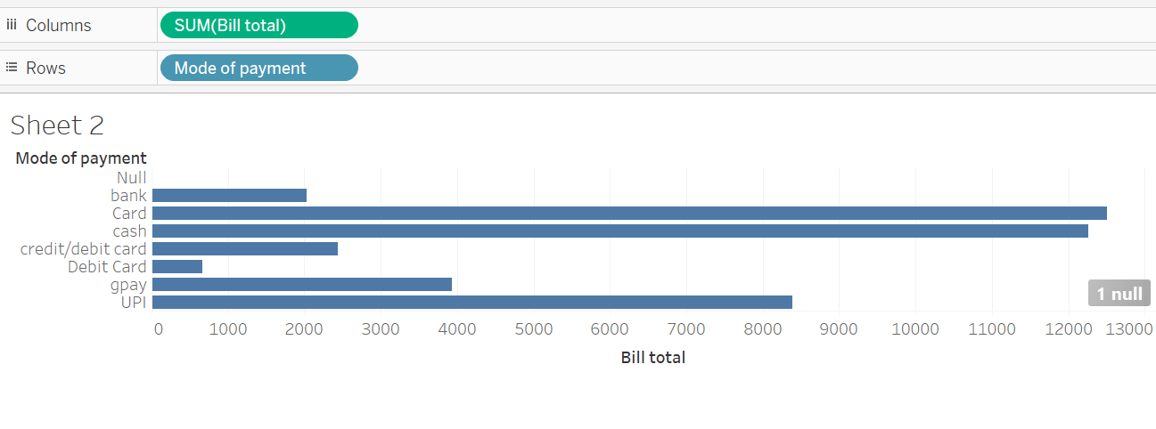
23. what is the most common mode of payment used in the dataset?

Slide 38
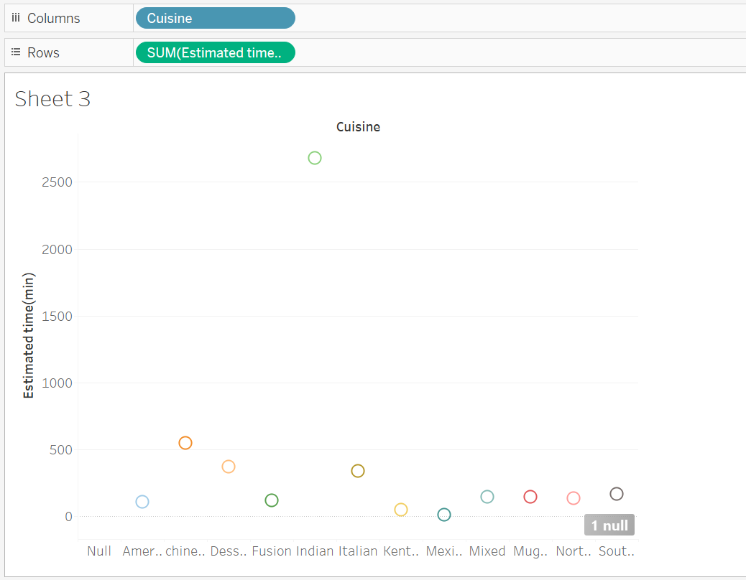
24. Which cuisine took longest time to be delivered in the dataset?

Slide 39
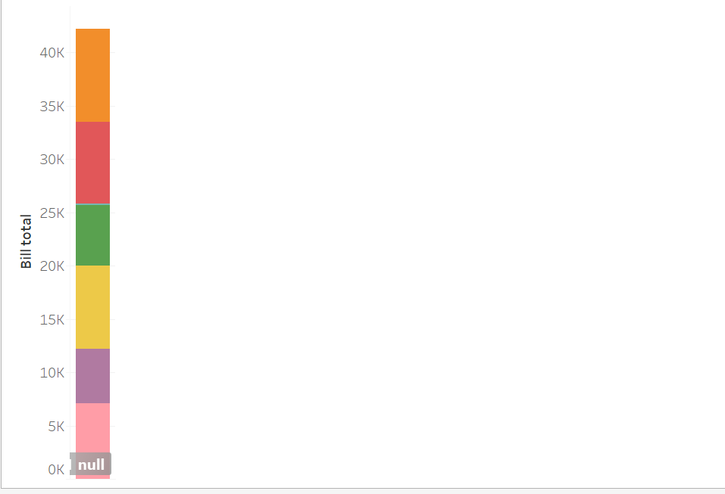
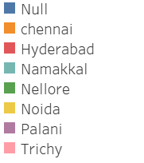
25. which place had the highest bill amount in the data set??

Slide 40
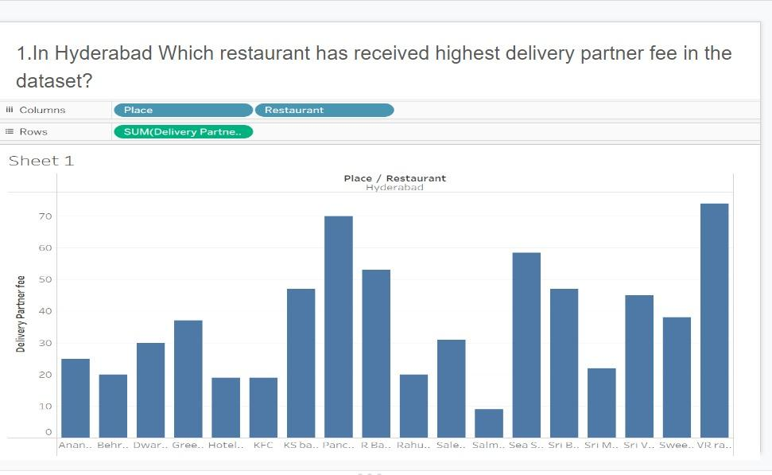
26.

Slide 41
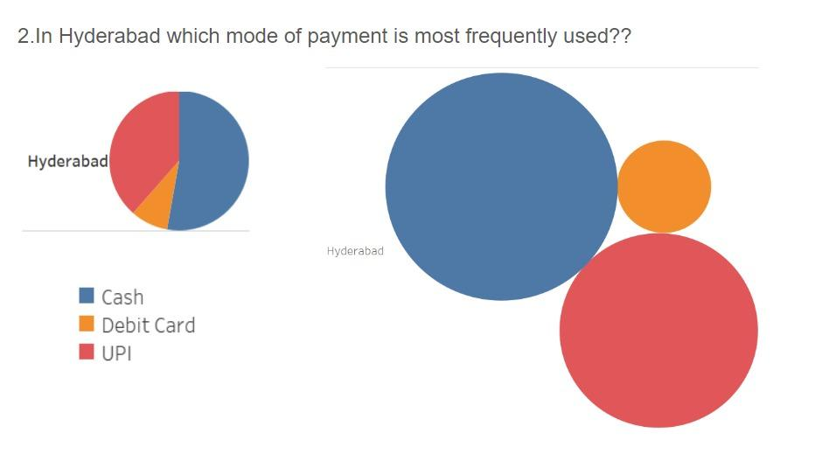
27.

Slide 42
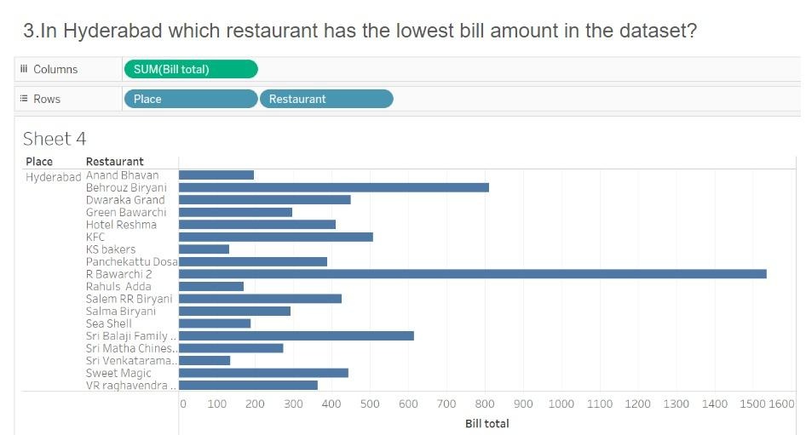
28.

Slide 43
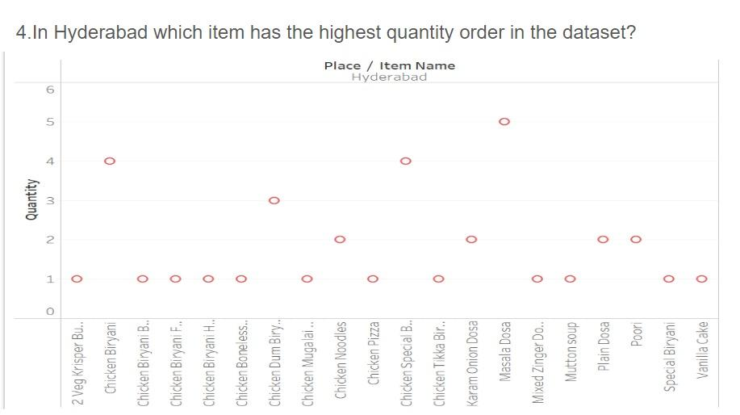
29.

Slide 44
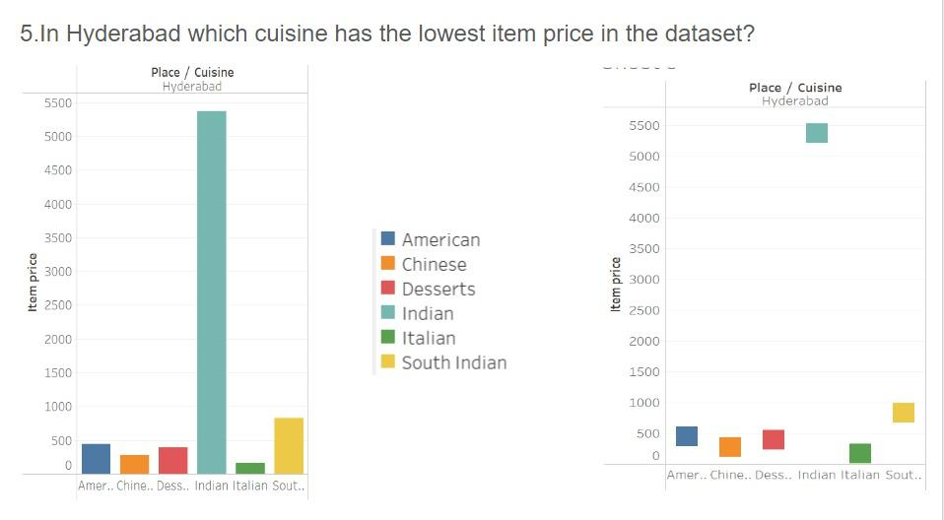
30.

Slide 45
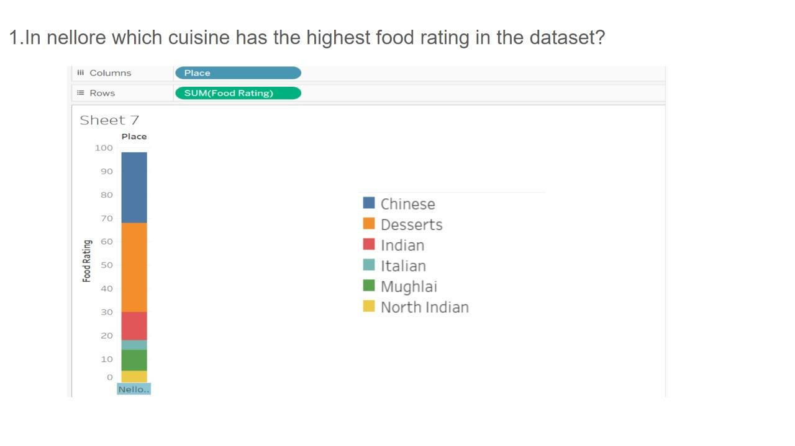
31.

Slide 46
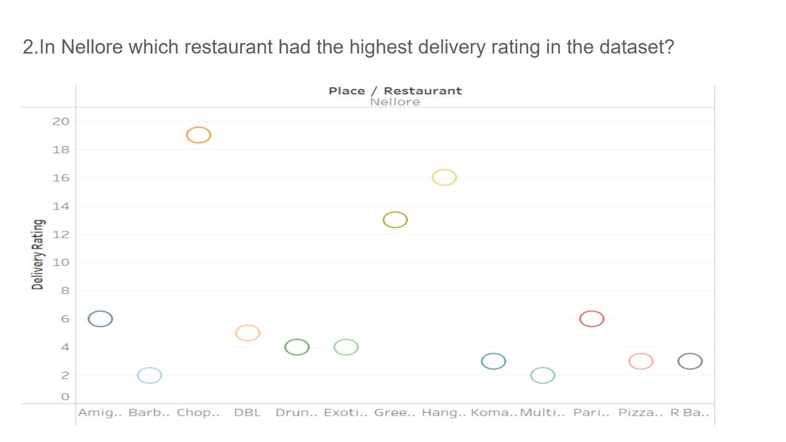
32.

Slide 47
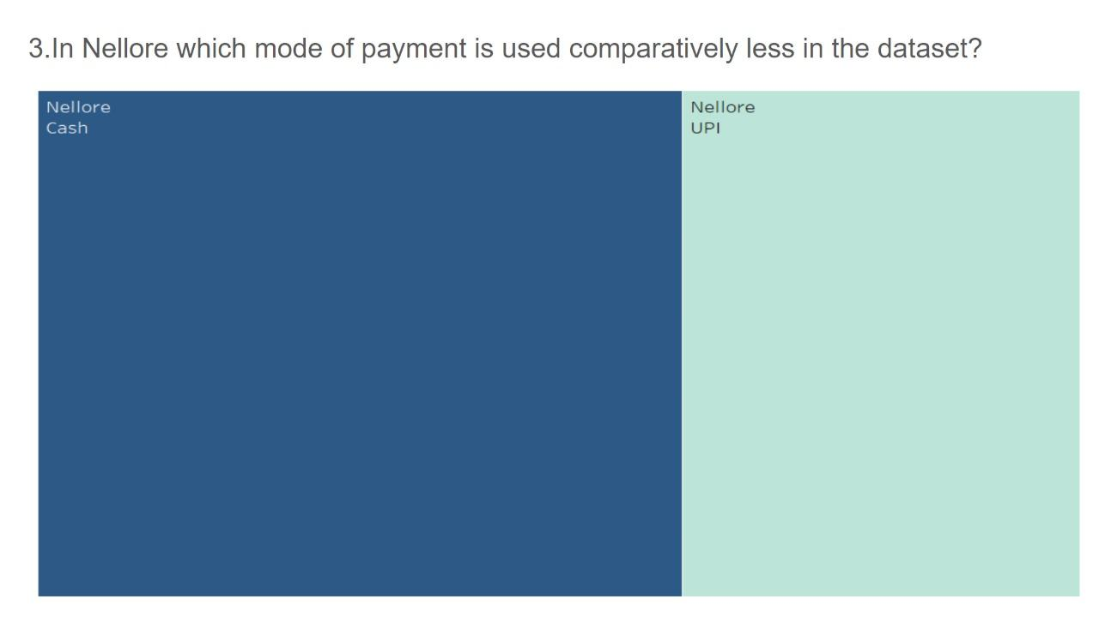
33.

Slide 48
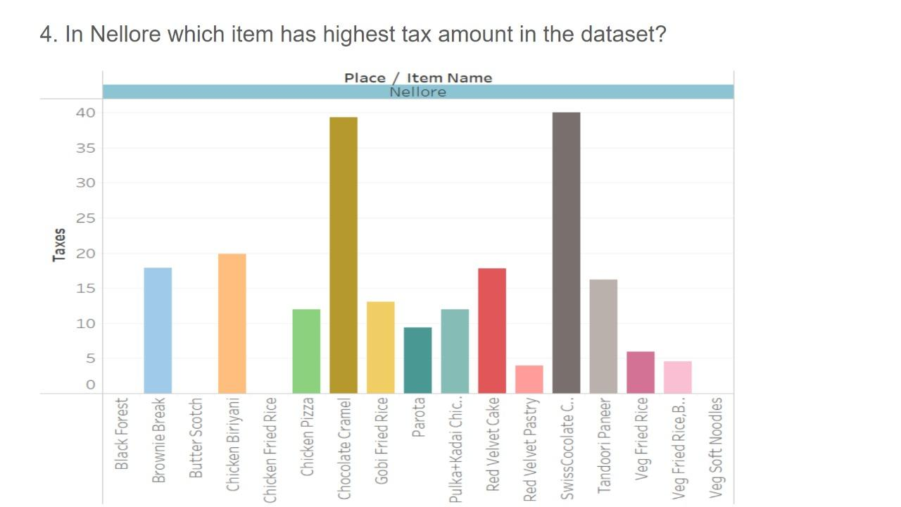
34.

Slide 49
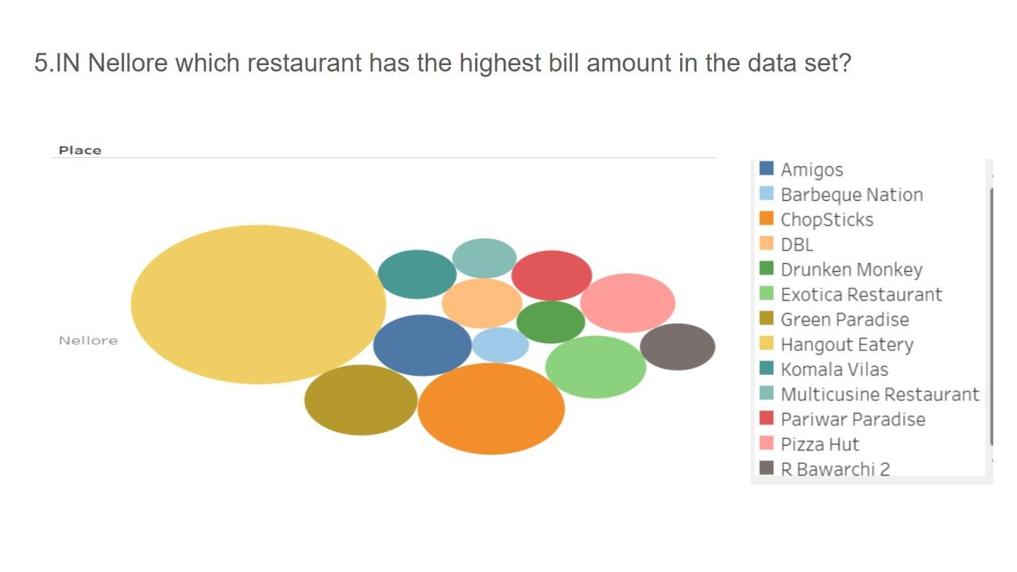
35.

Slide 50
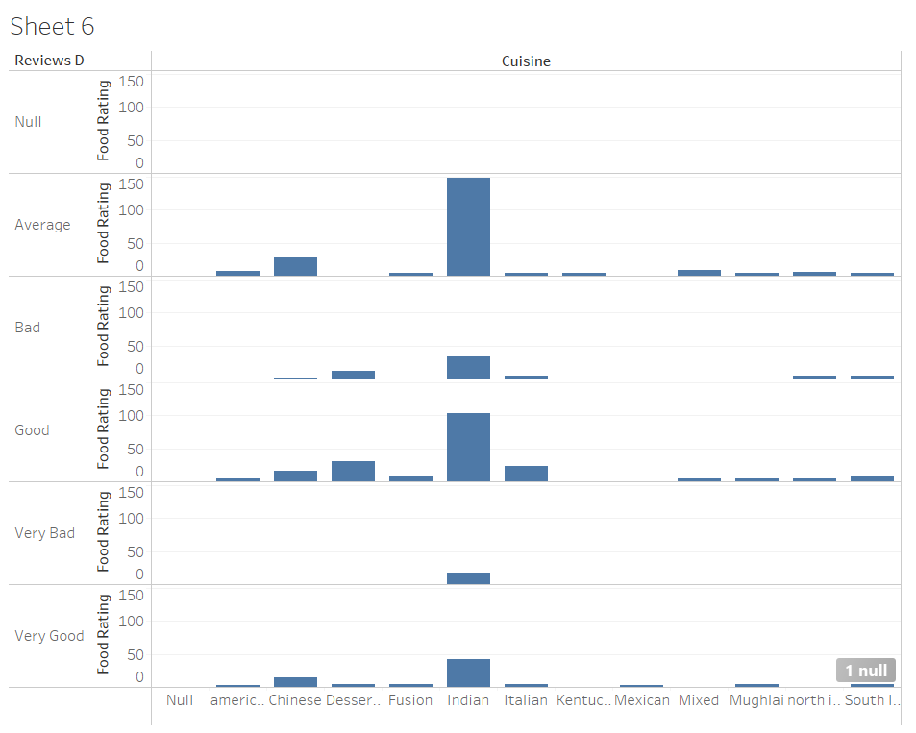
36. Which cuisine got very good delivery rating with best food rating from the customers ?

Slide 51
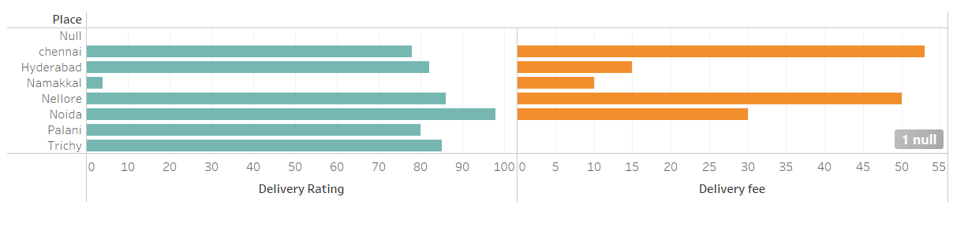
37. Interpret the following graph which place got the best delivery rating and took less delivery fee ?

Slide 52
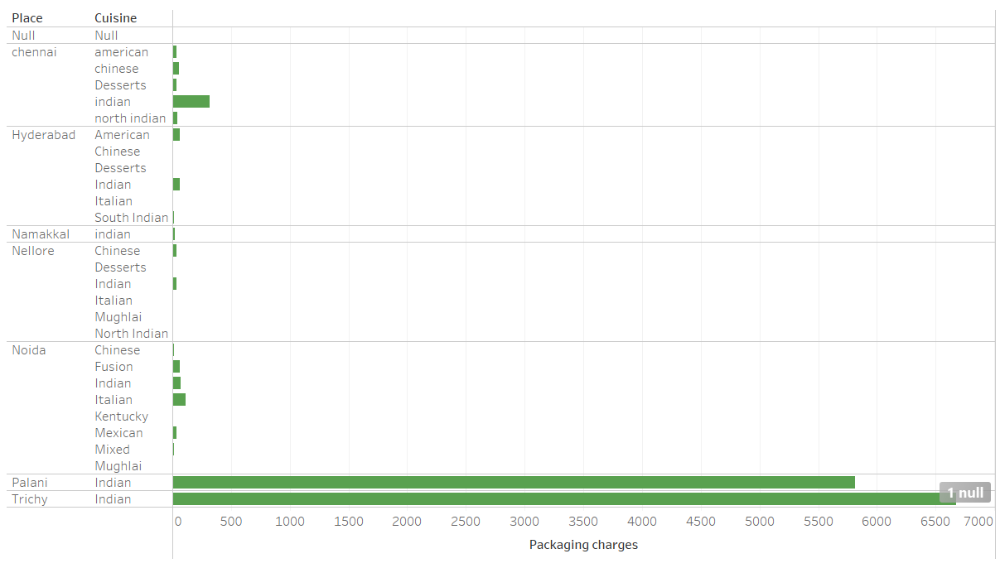
38. How much does it costs for packaging charges in Chennai to deliver a Indian cuisine ?

Slide 53
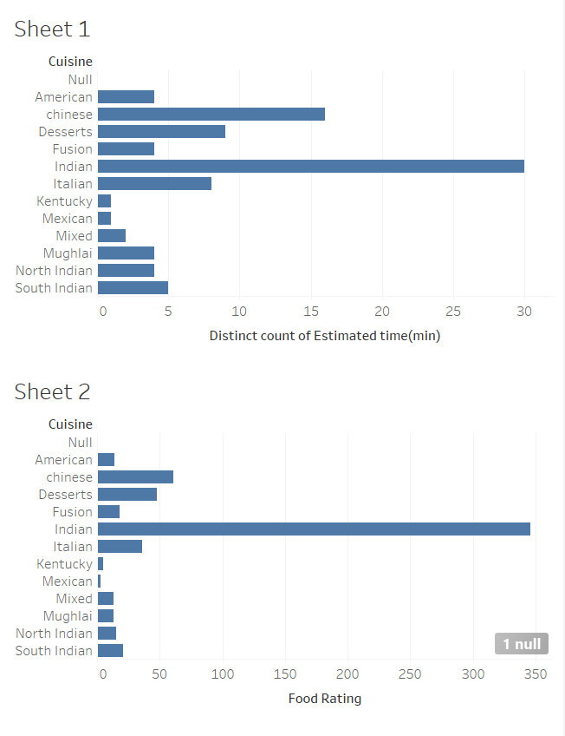
39. Estimate the average time taken to deliver a Chinese cuisine in total dataset collected ?

Slide 54
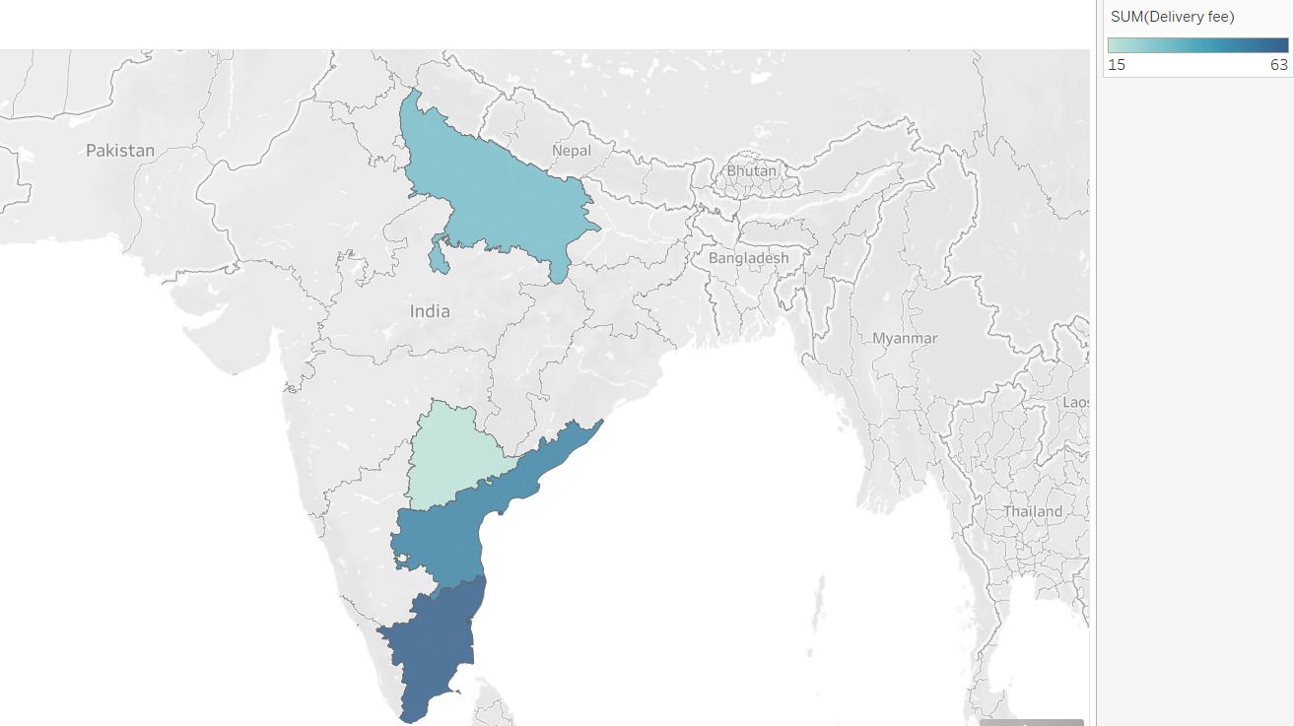
40. Which place got least delivery fee compared to other places in data collected ?

Slide 55
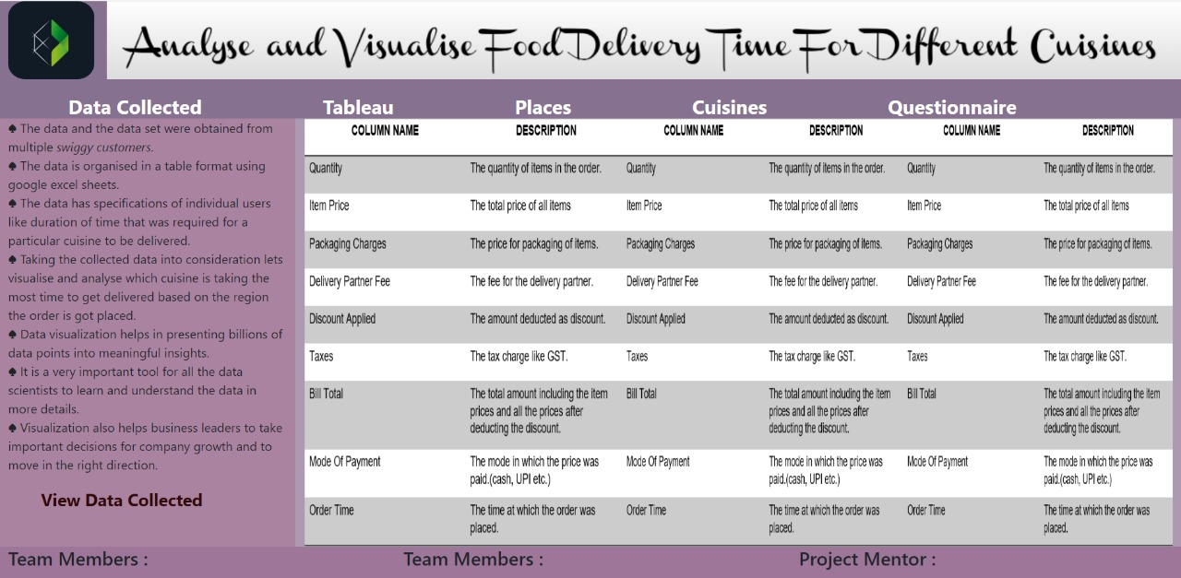
WEBSITE SCREENSHOTS

Slide 56


Slide 57


Slide 58


Slide 59


Slide 60


Slide 61


Slide 62


Slide 63


Slide 64


Slide 65


Slide 66

TIMELINE OF THE WORK

Slide 67


Slide 68
REFERENCES
https://github.com/GloriaChen0715/Food-Delivery-Time-Prediction
https://bytes.swiggy.com/the-swiggy-delivery-challenge-part-one-6a2abb4f82f6
https://github.com/chiragsamal/Predict-Food-Delivery-Time

Slide 69
Thank you

